Slide 1
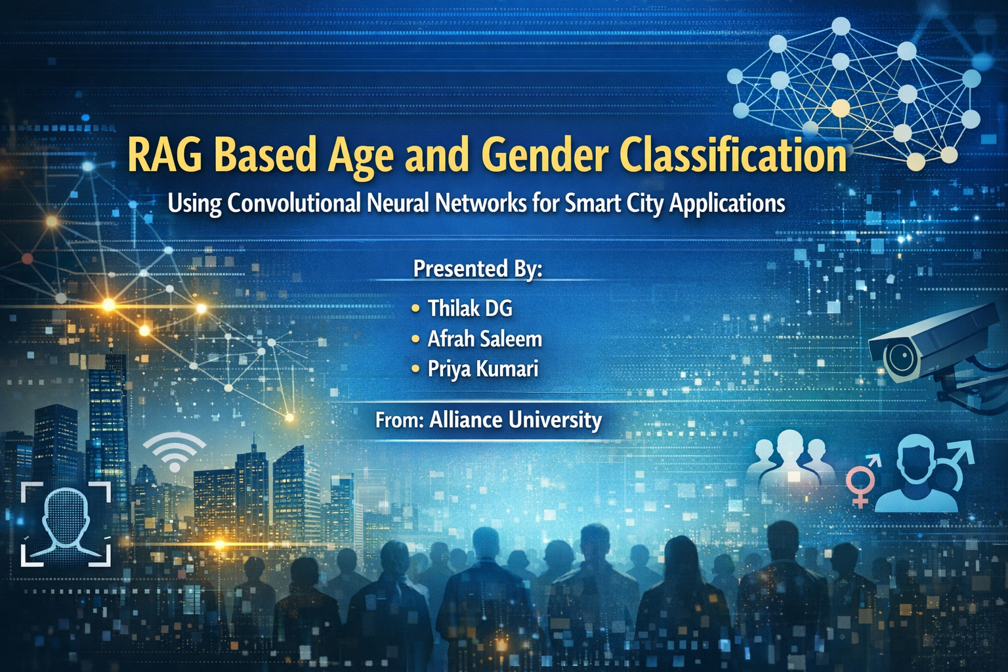
RAG-Based Age and Gender Classification Using Convolutional Neural Networks for Smart City Applications

Slide 2


SMART CITIES
The Need for Smart City Intelligence
Modern smart cities depend on artificial intelligence to process vast amounts of data streaming from sensors, cameras, and IoT devices across urban landscapes. While Deep Learning architectures like Convolutional Neural Networks excel at perception tasks—detecting and classifying faces with remarkable accuracy—they fall short in two critical areas: contextual reasoning and explainability.
Our innovative solution combines CNN perception with RAG (Retrieval-Augmented Generation) to create a hybrid framework that doesn't just predict demographics but generates human-readable, policy-aligned insights that urban planners can act upon with confidence.

Slide 3

Limitations of Current Urban Planning
Lack of Real-Time Data
Inefficiency at Scale
Scalability Challenges
Municipal authorities struggle to obtain immediate demographic insights, relying instead on outdated census data that may be years behind current population dynamics.
Manual data collection methods are prohibitively expensive, incredibly time-consuming, and vulnerable to human error—making them unsuitable for dynamic urban environments.
Traditional demographic analysis methods simply cannot scale to meet the demands of real-time monitoring across multiple city locations simultaneously.
Our Objective: Develop an automated AI system for ethical demographic estimation that supports sustainable, data-driven city planning while respecting privacy and maintaining transparency.

Slide 4
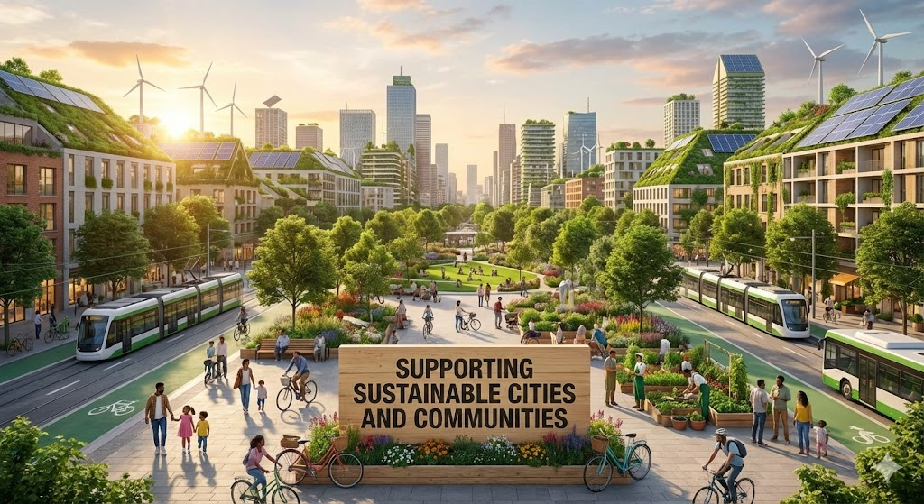




SDG 11
Supporting Sustainable Cities and Communities
Data-Driven Planning
Ethical Analytics
Enables explainable urban planning decisions using real-time demographic analytics that city officials can trust and act upon.
Performs demographic analysis without identity recognition, ensuring privacy-first approaches that respect citizen rights.
Policy Alignment
Decision support grounded in trusted government guidelines, urban planning reports, and internationally recognized sustainability frameworks.

Slide 5
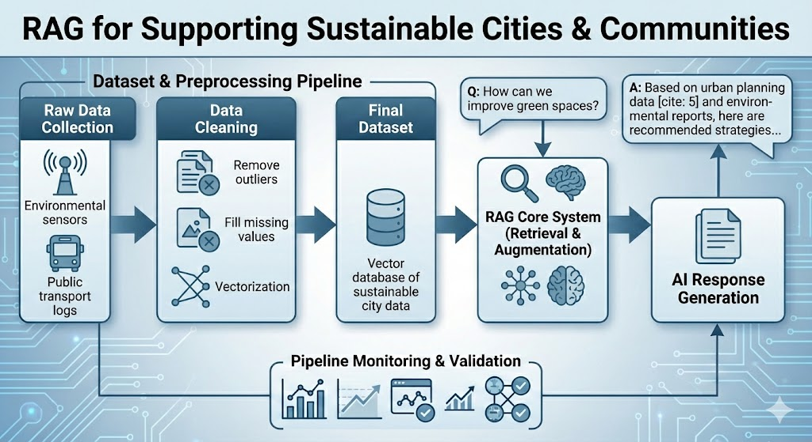
Dataset & Preprocessing Pipeline
UTKFace Dataset
Preprocessing Steps
Our model is trained on the comprehensive UTKFace dataset, containing diverse facial images with demographic annotations.
01
Normalization
Age Range: 0–116 years with continuous labels
Pixel values scaled to [0,1] range by dividing by 255
Gender Labels: Binary classification (0=Male, 1=Female)
02
Image Format: Resized to 128×128×3 RGB channels
Data Splitting
Separation into training and testing sets with stratification
Storage: Optimized NumPy arrays (X_train.npy, y_age_train.npy) for efficient loading
03
Reshaping
Tensor formatting for CNN input compatibility

Slide 6



A Three-Layer Hybrid Architecture
Our innovative framework integrates deep learning perception with knowledge retrieval and natural language generation to deliver actionable urban intelligence.
Perception Layer (CNN)
Convolutional neural network predicts age (regression) and gender (classification) from facial images with high accuracy and speed.
Retrieval Layer
Vector database stores embeddings of SDG documents, urban policies, and census reports. Similarity search (FAISS/ChromaDB) fetches relevant contextual information.
Generation Layer (LLM)
Large language model synthesizes CNN predictions with retrieved documents to generate natural language insights and recommendations for urban planners.

Slide 7
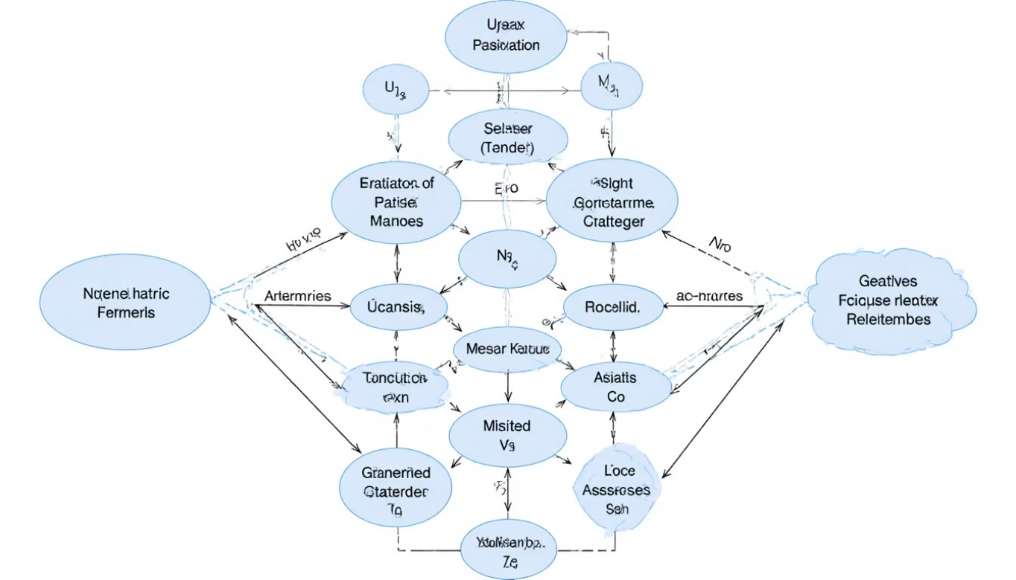
CNN Model Architecture
Network Design
Our convolutional neural network employs a sophisticated architecture optimized for demographic prediction from facial images.
Structure: 4 convolutional layers with ReLU activation functions
Regularization: MaxPooling layers and Dropout (0.3-0.5) to prevent overfitting
Dual Output Heads: Age regression and gender classification branches
Training Configuration
Optimizer: Adam with learning rate 0.0008
Loss Functions: MAE for age, Binary Cross-Entropy for gender
Callbacks: ReduceLROnPlateau and EarlyStopping for optimal convergence

Slide 8
RAG Pipeline Workflow
FROM IMAGE TO INSIGHT
Input Image
1
Facial image captured from urban environment (e.g., metro station crowd)
2
CNN Perception
Deep learning model predicts demographics (e.g., "Female, Age 20-30")
Query Formulation
3
Convert predictions into structured search query for knowledge base
4
Context Retrieval
Fetch relevant SDG 11 guidelines and urban mobility reports
Insight Generation
5
LLM produces actionable summary and policy recommendations

Slide 9

Model Evaluation & Performance
Our CNN model demonstrates strong performance across both age regression and gender classification tasks, validated through comprehensive testing on the UTKFace dataset.
94%
4.2
87%
Gender Classification Accuracy
Age MAE (Years)
Age Tolerance Accuracy
High precision in binary gender prediction across diverse demographic groups
Low Mean Absolute Error demonstrates accurate age prediction capability
Predictions within ±5 years of actual age, sufficient for urban planning applications
Performance metrics show consistent improvement across training epochs, with gender accuracy stabilizing at high levels and age prediction achieving practical precision for demographic analysis.

Slide 10


Sample Output & Real-World Application
CNN Demographic Analysis
Average Age Range: 20–35 years
Gender Distribution: 55% Female, 45% Male
Sample Size: 247 individuals detected
Input Scenario
Crowd image captured at major metro station during peak hours
RAG-Generated Insight
"Based on SDG 11 guidelines and urban mobility reports, the higher concentration of young adults (ages 20-35) suggests the need for increased public transport frequency during peak hours, enhanced safety measures including better lighting and security presence, and employment-oriented infrastructure development near major transit hubs. The balanced gender distribution indicates successful inclusive transit policies, though continued monitoring is recommended to ensure sustained accessibility for all demographic groups."
Impact: This actionable insight enables city planners to make data-driven decisions about infrastructure investment, service scheduling, and policy development—all while maintaining ethical privacy standards.

Slide 11
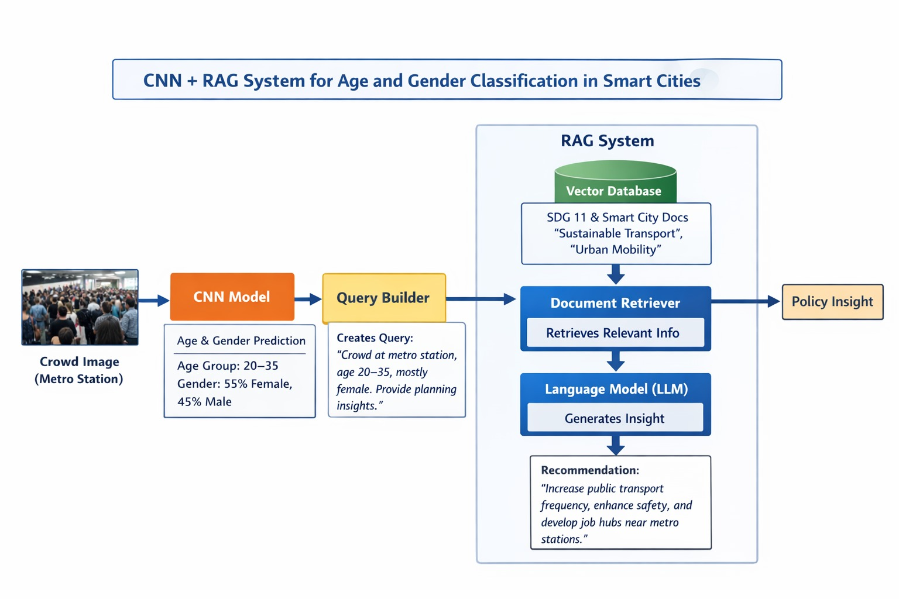
Prototype

Slide 12
Prototype Overview & Objectives
Goal: Supporting Sustainable Cities and Communities (SDG 11).
Core System: Integrated CNN + RAG framework for Smart City analysis.
Target Data: Real-time demographic perception from high-traffic areas like metro stations.
Key Output: Evidence-based Policy Insights for urban planners.

Slide 13
Workflow
Visual Analysis: Perception Layer Input Processing: High-resolution imagery from locations like metro stations is fed into a Convolutional Neural Network (CNN).
Demographic Extraction: The CNN performs real-time classification to predict the age group (e.g., 20–35) and gender distribution (e.g., 55% Female) of the crowd.
Contextualization: Semantic Bridge Query Synthesis: The Query Builder translates raw demographic percentages into a structured, natural language prompt.
Contextual Framing: It creates a specific request—such as "Provide planning insights for a young, predominantly female crowd at a metro station"—to guide the AI’s focus.
Knowledge Retrieval: The RAG Framework Authoritative Retrieval: The system queries a Vector Database populated with SDG 11 frameworks, sustainable transport research, and Smart City documentation.
Document Grounding: The Document Retriever pulls only the most relevant expert segments to prevent the AI from "hallucinating" or providing generic advice.
Strategic Action: Synthesis & Output LLM Integration: A Large Language Model (LLM) synthesizes the retrieved expert data with the specific crowd demographics.
Policy Recommendations: The final output provides high-value Policy Insights, such as optimizing public transport frequency, enhancing lighting for safety, or developing nearby job hubs.

Slide 14
